Slide 1


























Slide 2















Slide 3


































Slide 4
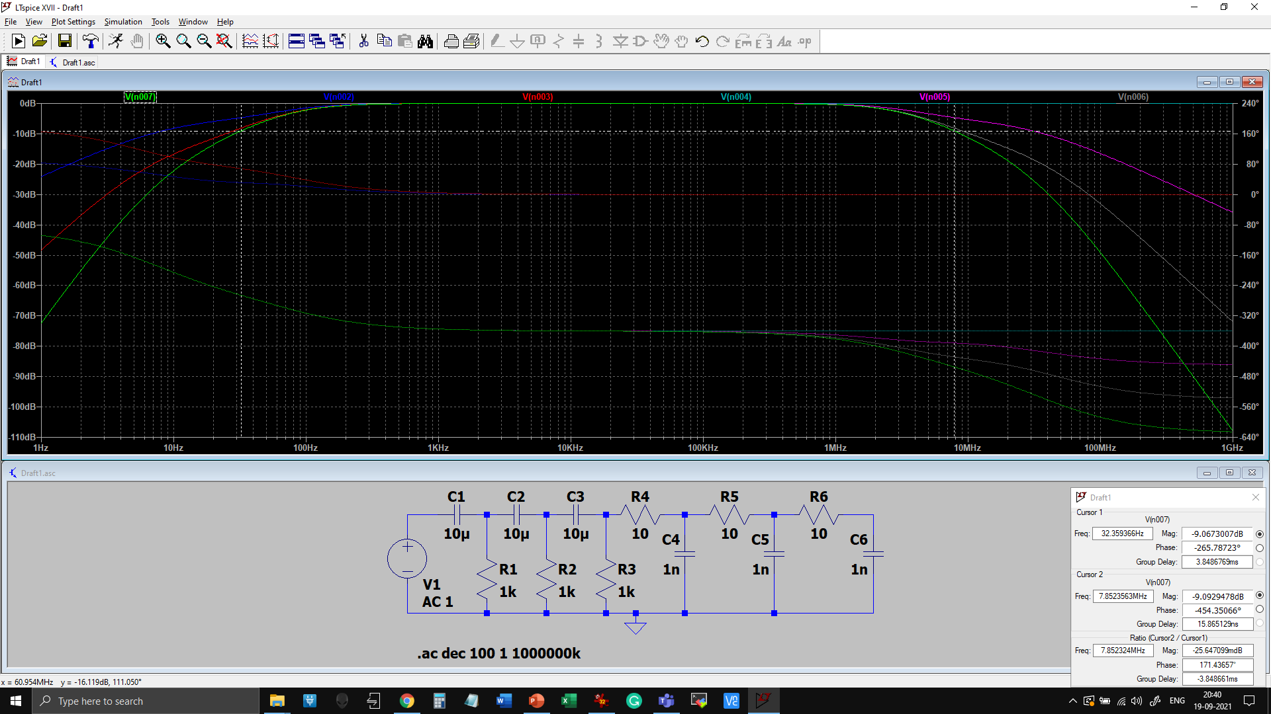
















Slide 5



























Slide 6
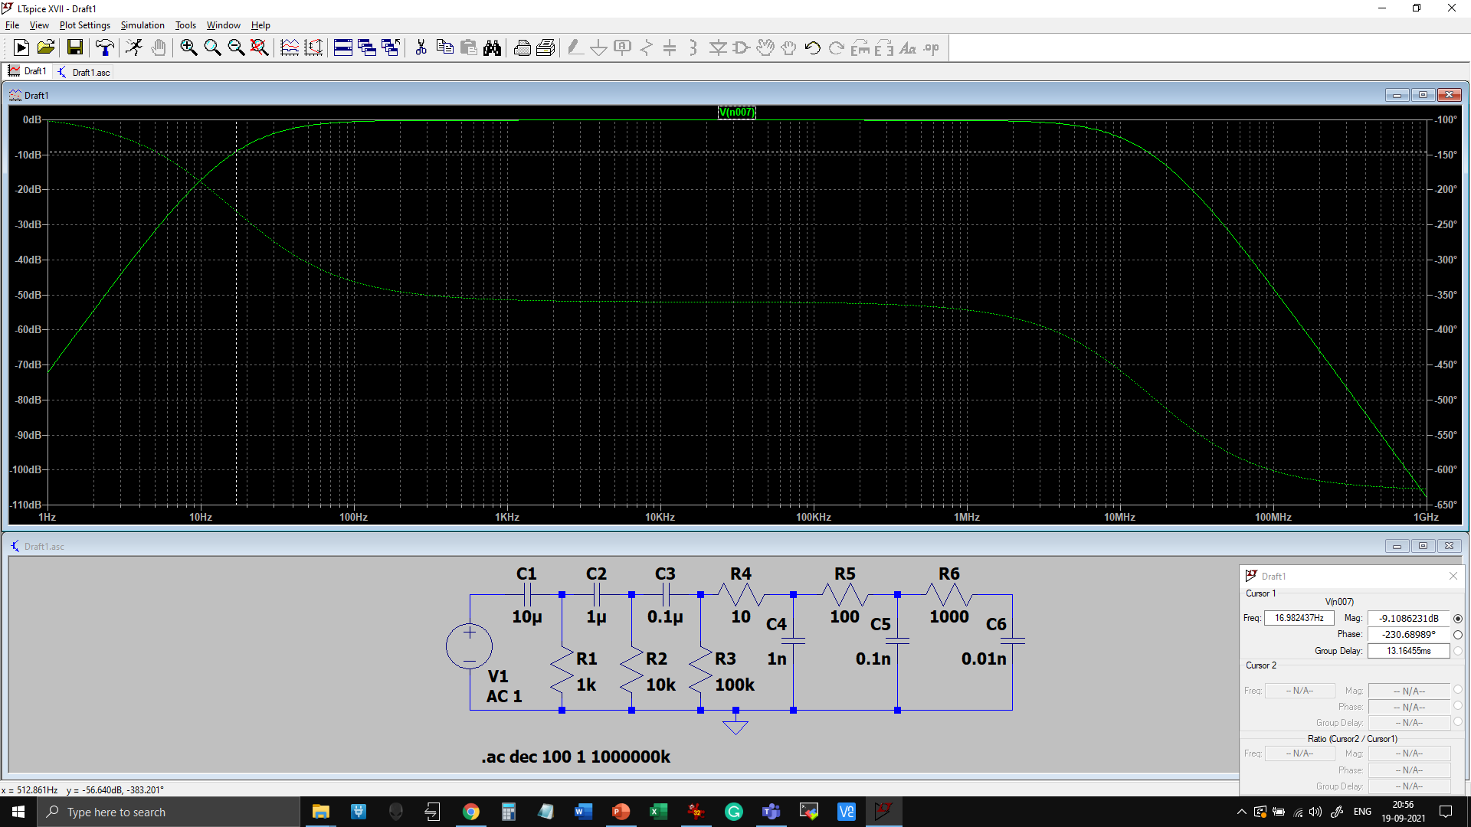






We are now getting a closer values to the theoretical cut-off frequencies at -9db, while reducing the loading effect.

